Slide 1
WEB SCRAPING PROJECT SPOTHERO
OZGE USAL
AUGUST 2022

Slide 2
CONTENT
Information
about the
Website
Raw & Cleaned
Data
Conclusions & Challenges
1
3
5
2
4
6
Visualizations
Next Steps & Resources
Aim & Motivation

Slide 3
Information about the Website

Slide 4

spothero
Since launching in 2011, SpotHero has been paving the way for millions of drivers to easily find affordable parking at more than 7,500 garages, and lots in over 300 major North American cities.
Spot Hero provides easy parking for all. Based in Chicago, SpotHero is led by founders Mark Lawrence and Larry Kiss

Slide 5






CORE VALUES OF WEBSITE
Give Drivers the Right of Way
Don’t Get Stuck in Traffic
Drive Growth
Fuel Relationships
Remember to Signal
Respect Fellow Drivers

Slide 6
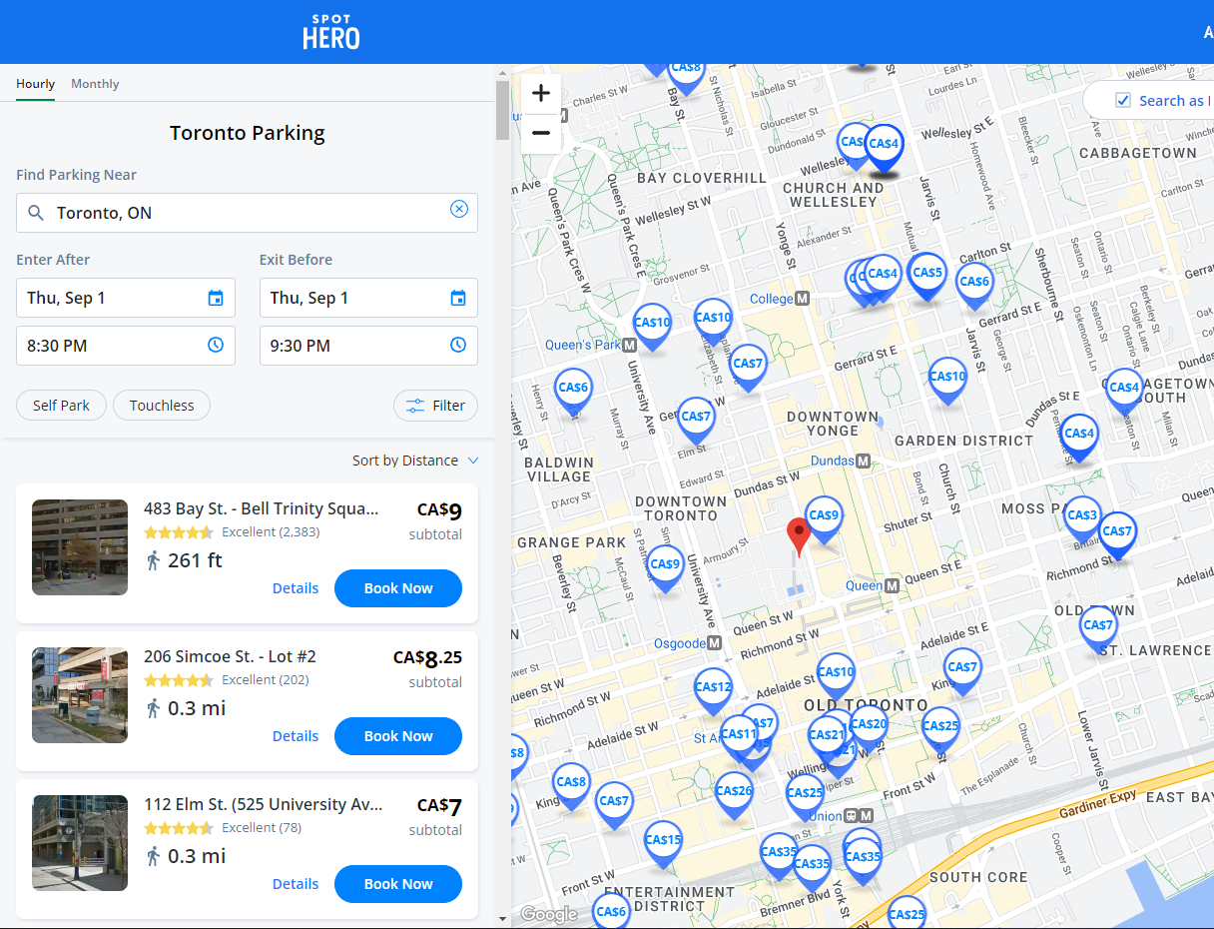

WEBSITE

Slide 7
AIM & MOTIVATION
Aim: Analyzing parking spots and classifying them to their locations, amenities, prices, and efficiencies facilitate the selection of suitable parking spots.
Motivation: The website provides a search bar to find parking spots according to their address and cities across North America. I could gain addresses, reviews, amenities, access hours, and prices of parking spots from this website.

Slide 8
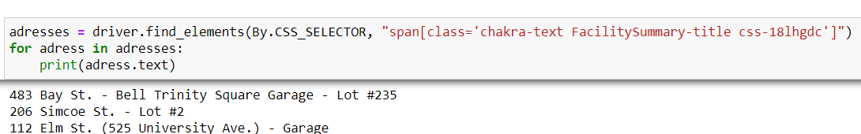
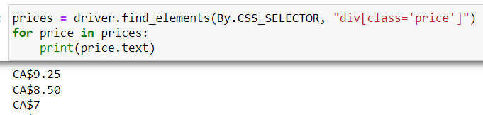
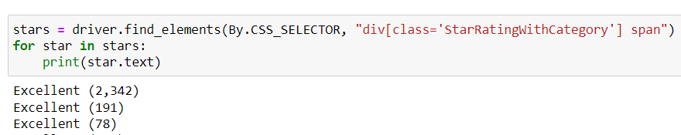
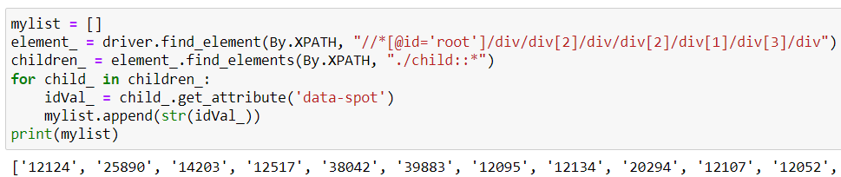
Raw data
Firstly, I took addresses and garage names, stars, hourly prices, and spot IDS separately

Slide 9
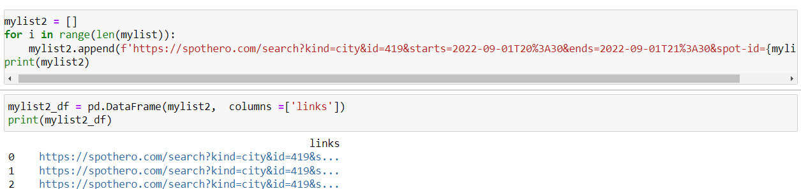
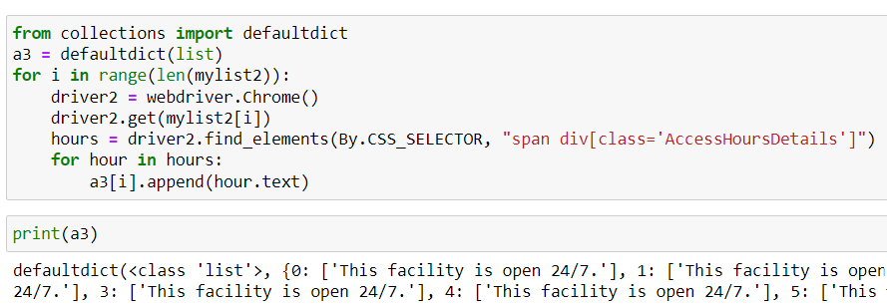
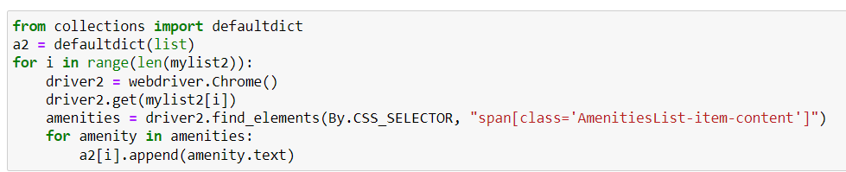
Raw data
Because of the amenities in detail links for each parking spot, I used spot IDs to create details links. Then, I applied web scraping for all detail links to take amenities and access hours data.

Slide 10
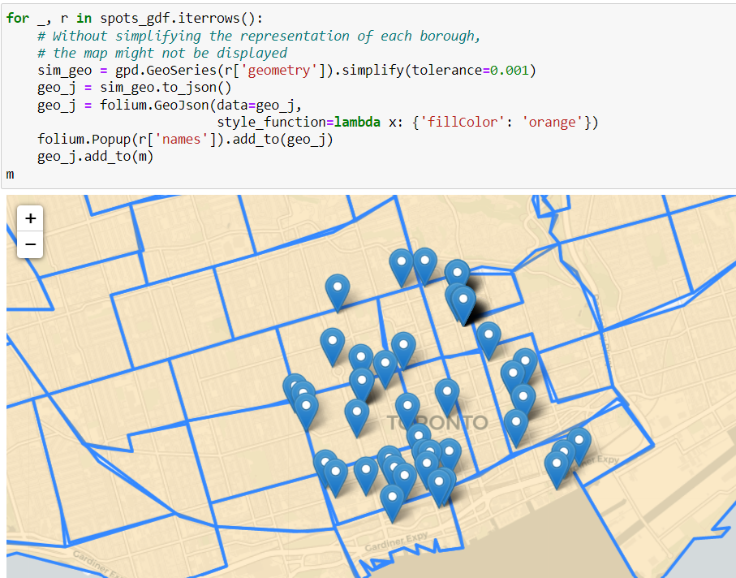
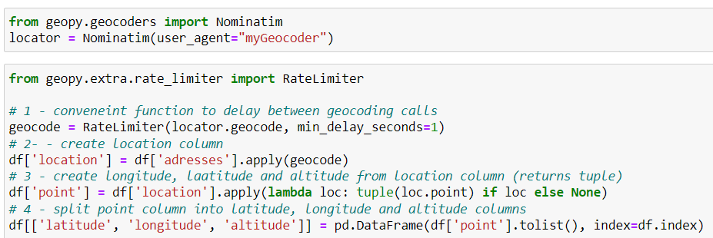
Raw data
Also, I applied to geocode processing to find coordinates of parking spots by using address information for showing on the map. Then, I intersected with neighborhood shapefile data for taking neighborhood information of spots by using GeoPandas.

Slide 11
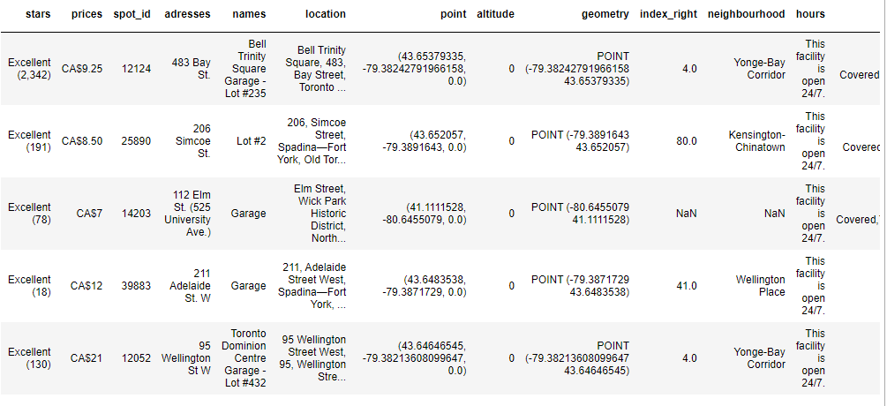
CLEANED data
After cleaning, manipulating, and merging processes :

Slide 12
131 rows
74 rows
As the Final 74 parking spots are used for analysis
Parking spot number taking by web scraping
After Geocoding

Slide 13
VISUALIZATIONS

Slide 14
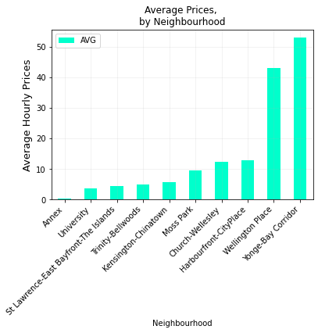
AVERAGE HOURLY PRICES BY NEIGHBOURHOODS

Slide 15
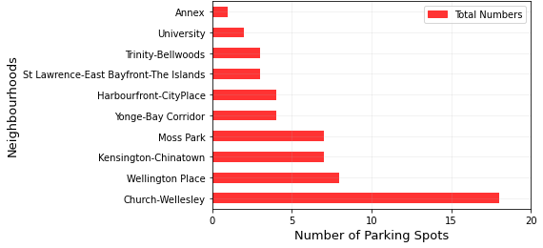
NUMBER OF PARKING SPOTS BY NEIGHBOURHOODS

Slide 16
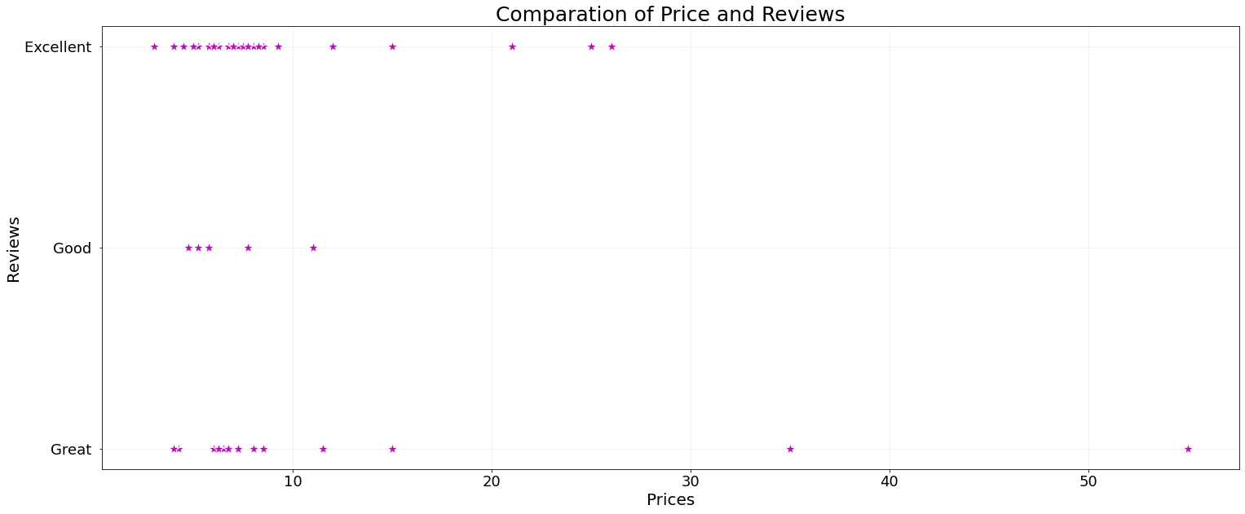
COMPARATION OF PRICES AND REVIEWS

Slide 17
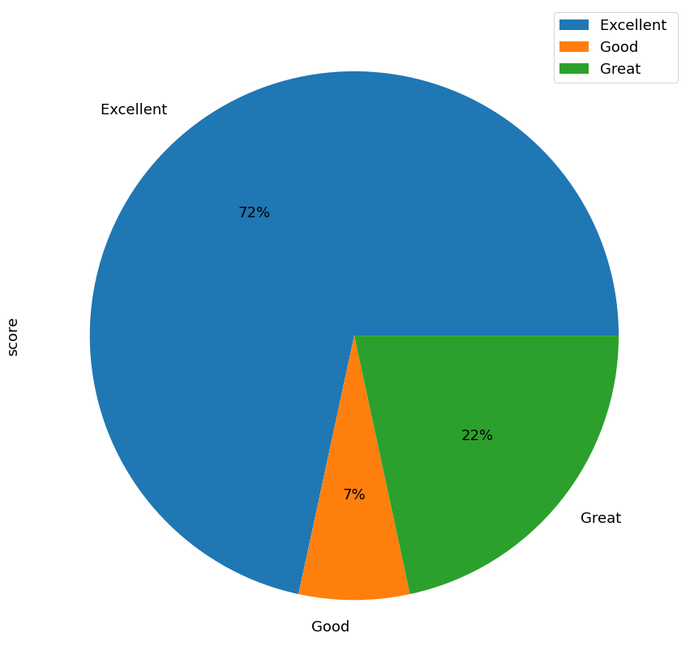
Percentages of scores

Slide 18
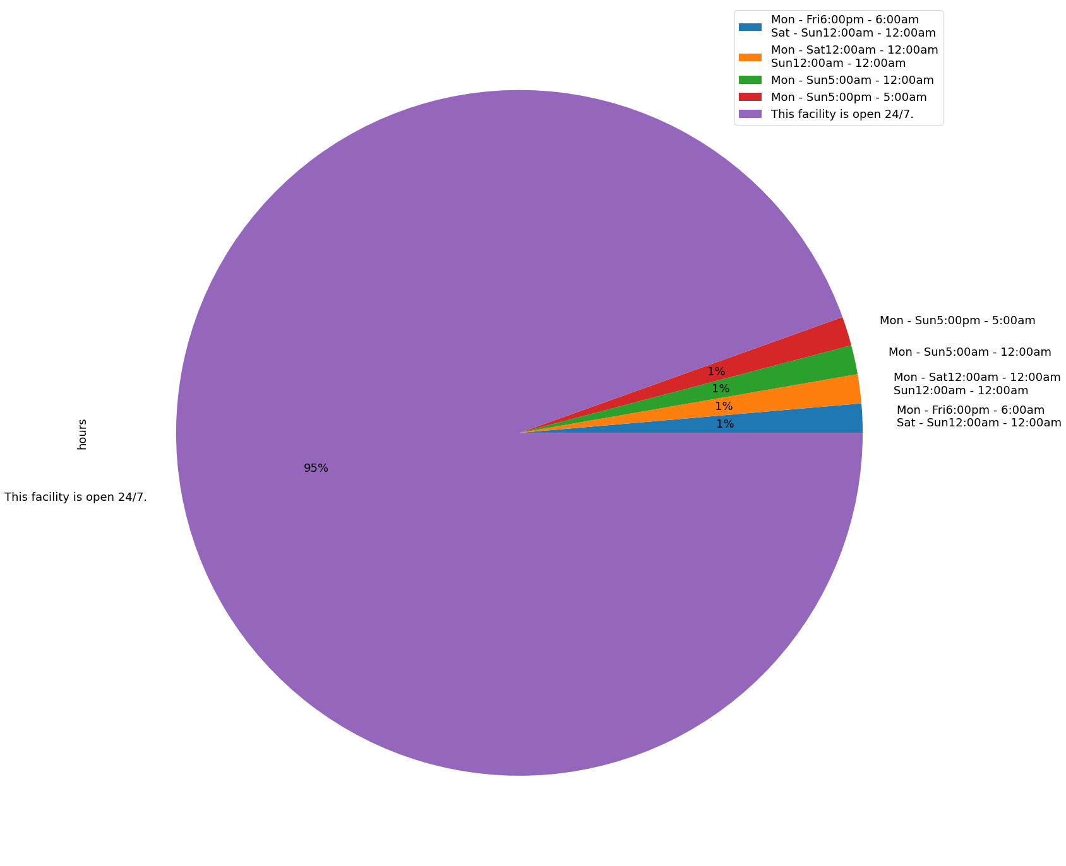
Percentages of OPEN-HOURS

Slide 19
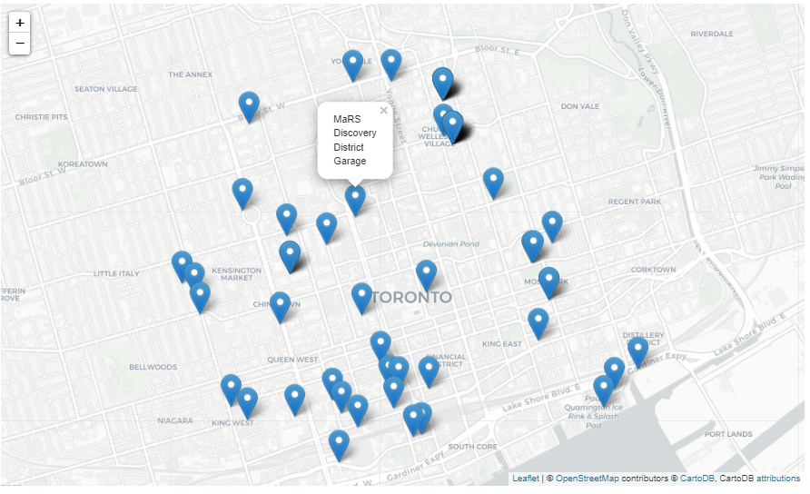
Map display

Slide 20
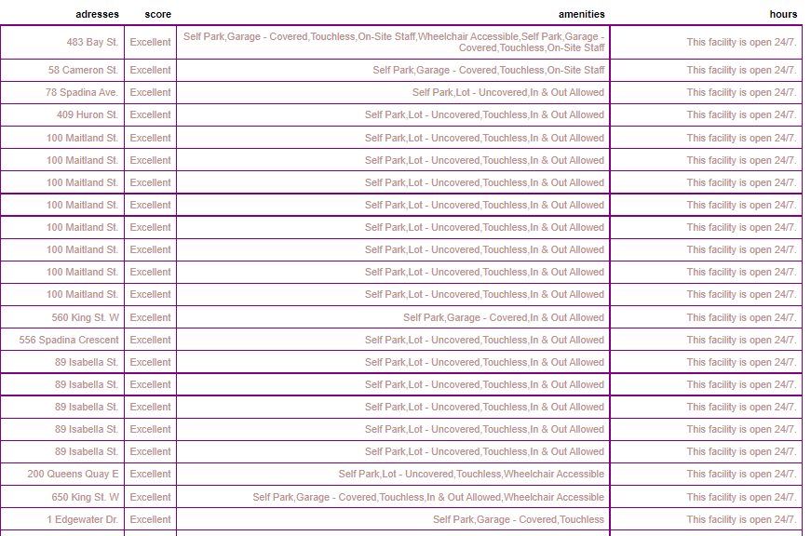
Table display of addresses, scores, amenities and hours

Slide 21
CONCLUSIONS
Yonge-Bay Corridor has a maximum average price, and Annex has a minimum average price for a one-hour parking spot.
Church-Wellesley has a maximum number of parking spots, and Annex has a minimum number of parking spots.
According to reviews, 72% of parking spots have Excellent score, 22% have Great score and 7% have a Good score.
When prices and reviews are compared, low prices have more reviews, and generally low prices have more excellent score.
According to open hours, 95% of parking spots are open 24/7.

Slide 22

chalanges
Taking spot IDs as a list by web scraping
Taking amenities and open hours data from multiple links by web scraping
Installing GeoPandas
Transposing and splitting data many times

Slide 23

NEXT STEPS
Taking monthly, airport and event parking spot data by web scraping
Developing the geocoding process to manipulate addresses column of sarking spots (for example: trimming (..) values)
Adding other locations in Greater Toronto Area (for example: Mississauga, Vaughan)
Classifying amenities as columns from one column
Developing mapping analyses

Slide 24
THANKS!
Any questions?

Slide 25
resources
https://spothero.com/about/
https://stackoverflow.com/
https://pandas.pydata.org/
https://open.toronto.ca/dataset/neighbourhoods/
https://geopandas.org/
https://towardsdatascience.com/geocode-with-python-161ec1e62b89
https://towardsdatascience.com/how-to-export-pandas-dataframe-to-csv-2038e43d9c03
https://learn.weclouddata.com/programs/1/courses/17a61c2a-bbac-42ff-9539-5ab86990eb79/weeks/1295/materials/9443
https://learn.weclouddata.com/programs/1/courses/17a61c2a-bbac-42ff-9539-5ab86990eb79/weeks/1299/materials/9496
https://learn.weclouddata.com/programs/1/courses/17a61c2a-bbac-42ff-9539-5ab86990eb79/weeks/1299/materials/9490
https://startupsmagazine.co.uk/article-week-7-next-steps
https://www.slidescarnival.com/quickly-free-presentation-template/2142

